Slide 1


INSTITUTE FOR ADVANCED COMPUTING AND SOFTWARE DEVELOPMENT AKURDI, PUNE
Documentation On
“Tiffin Trail WebApp”
PG-DAC Feb 2025
Submitted By:
Group No: 29
Roll No. Name:
252003 Abhimanyu Karche
252076 Raman Ghule
Mr. Harshal Waghchaure Mrs. Prashant Deshpande
Project guide Centre Coordinator

Slide 2
Index :
Introduction
Project Background
Technology Used
Users and Role
Diagrams
Feature Scope and Extension
Conclusion

Slide 3
Introduction
Purpose:
Tiffin Trail is a web application that connects customers with tiffin service providers by bringing the traditional lunch box system online. Users can browse meal options, subscribe, customize plans, and make secure online payments. Built with React.js (frontend) and Spring Boot (backend), it offers a responsive interface, secure login, and easy payment through Razor pay. The platform ensures convenient, transparent, and efficient meal delivery while helping vendors manage menus, orders, and deliveries effectively.

Slide 4
Project Background :
In the current competitive world, many youths travel to different unknown locations for their basic education or jobs. The main problem they face is the food they get, and they crave for homemade food, but it is difficult to find it. On the other hand, some housewives wish to work and earn money to gain financial independence. It is difficult for these ladies to reach customers and market their products.

Slide 5
Technologies Used
Frontend: React.js - 18.2.0
Backend: Spring Boot - 3.4.5
Security: Spring Security with JWT – 6.4.5
Database: MySQL – 8.0.33
Payment Gateway: Razor pay – 2.9.6
Tools: Model Mapper, Lombok – 1.18.38, Hibernate/JPA – 6.4.4.Final

Slide 6
Users and Roles:
Admin: Manages users, authorize vendors, and platform settings.
Seller: Creates and manages tiffin menus, views and processes orders and defines subscriptions plans.
Customer: Browses menus, places orders, get Subscriptions, customizes meal plans.

Slide 7
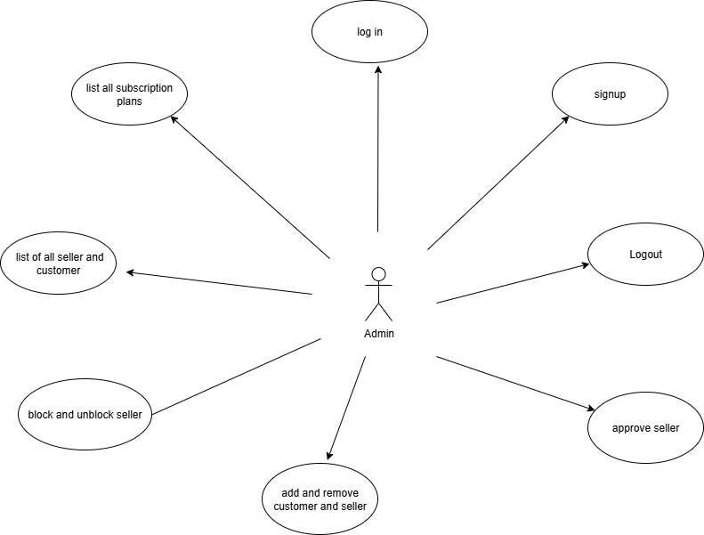
Use Case Diagrams: Admin Use Case Diagram:

Slide 8
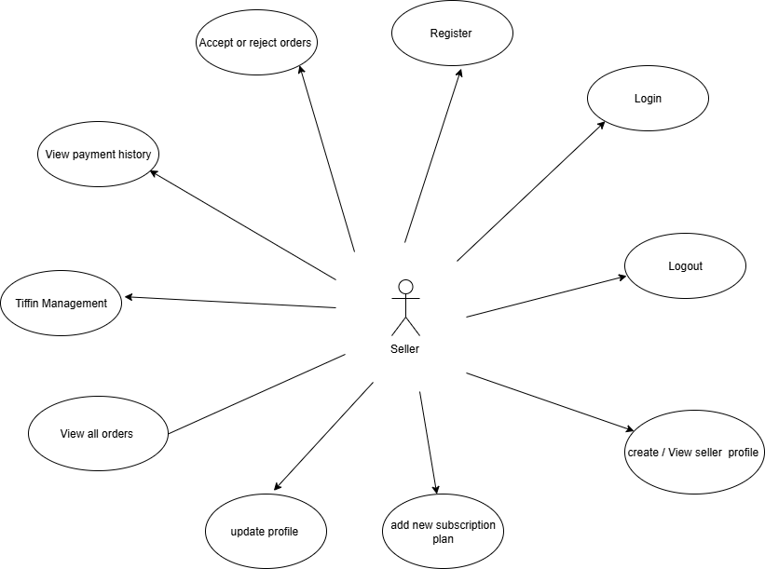
Seller Use Case Diagram:

Slide 9
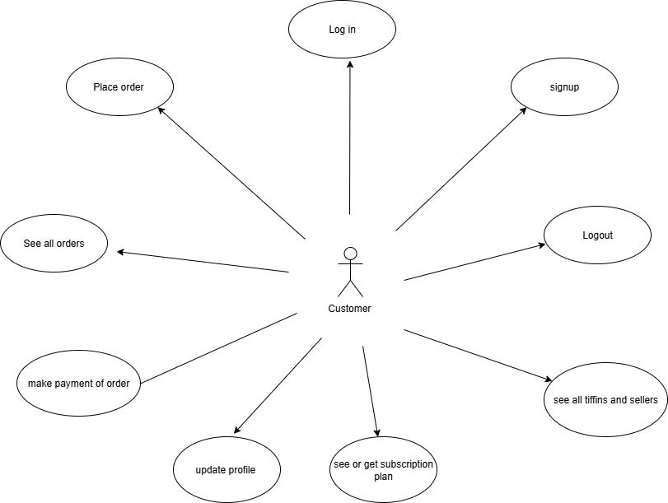
Customer Use Case Diagram:

Slide 10
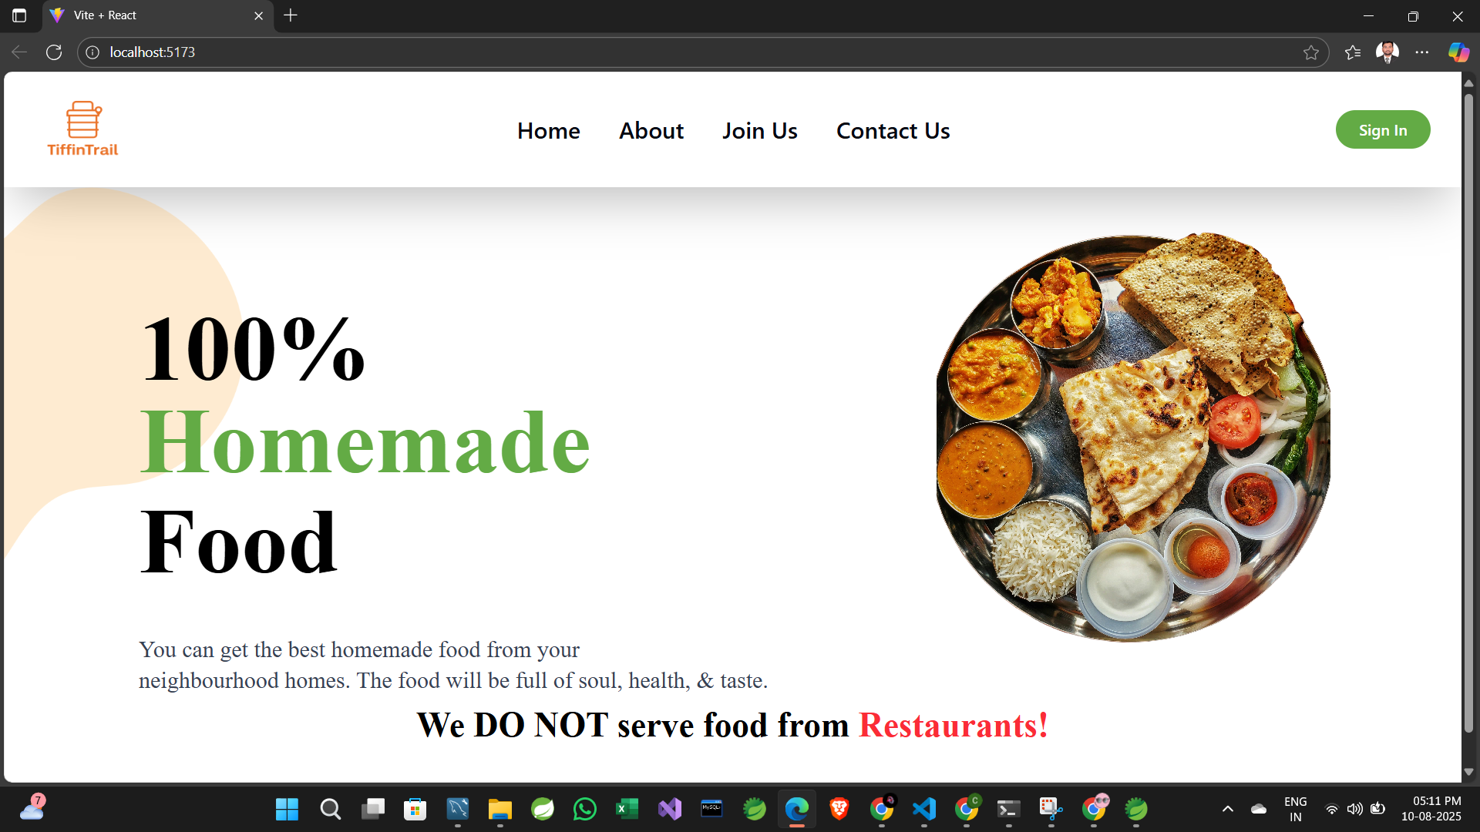
Screenshots:
Home page:

Slide 11
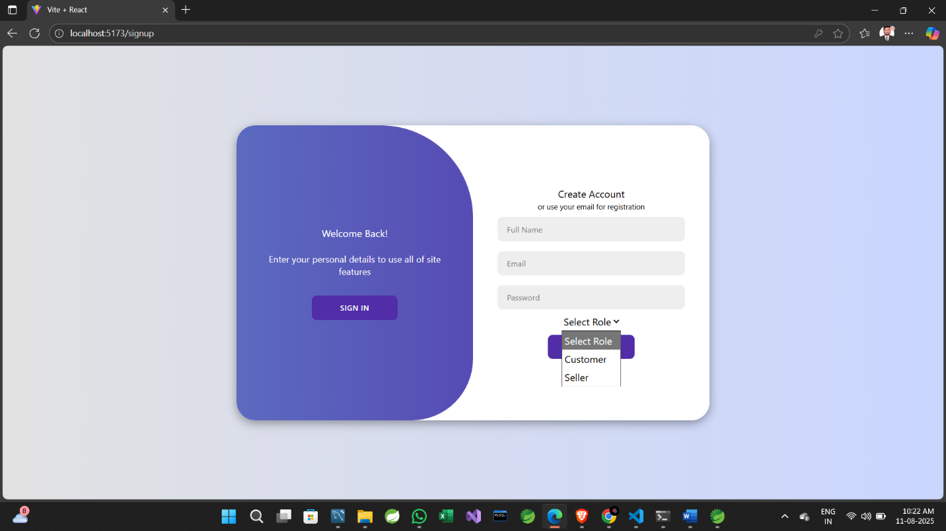
Sign up page:

Slide 12
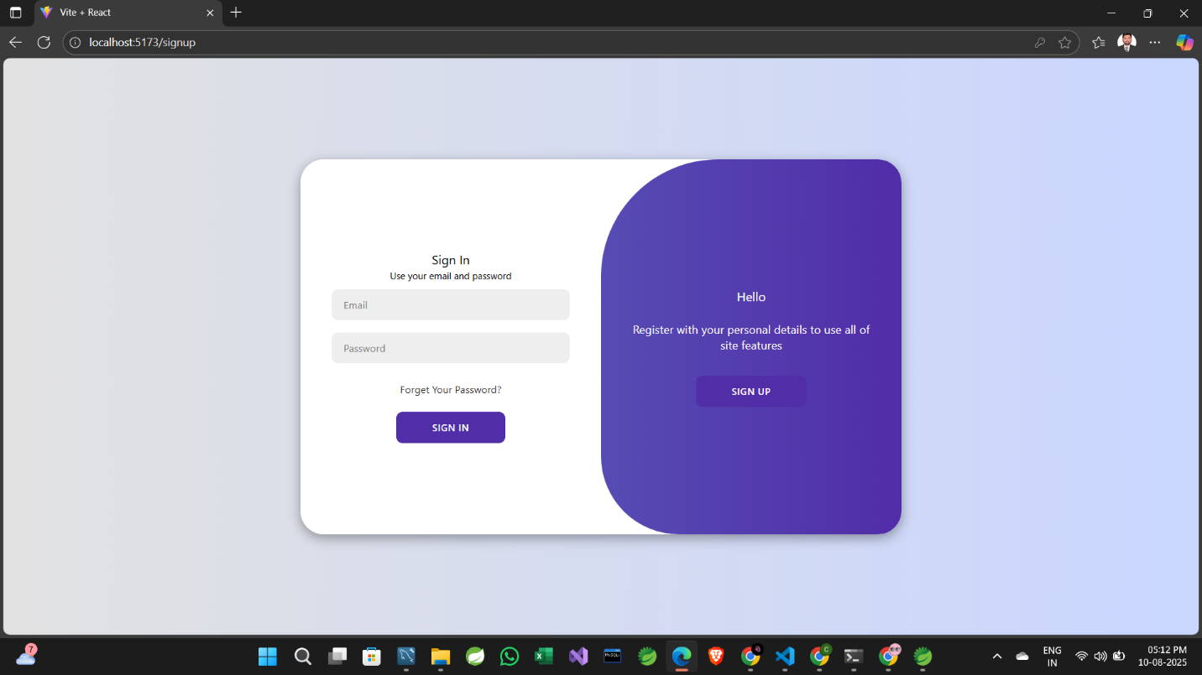
Sign in page:

Slide 13
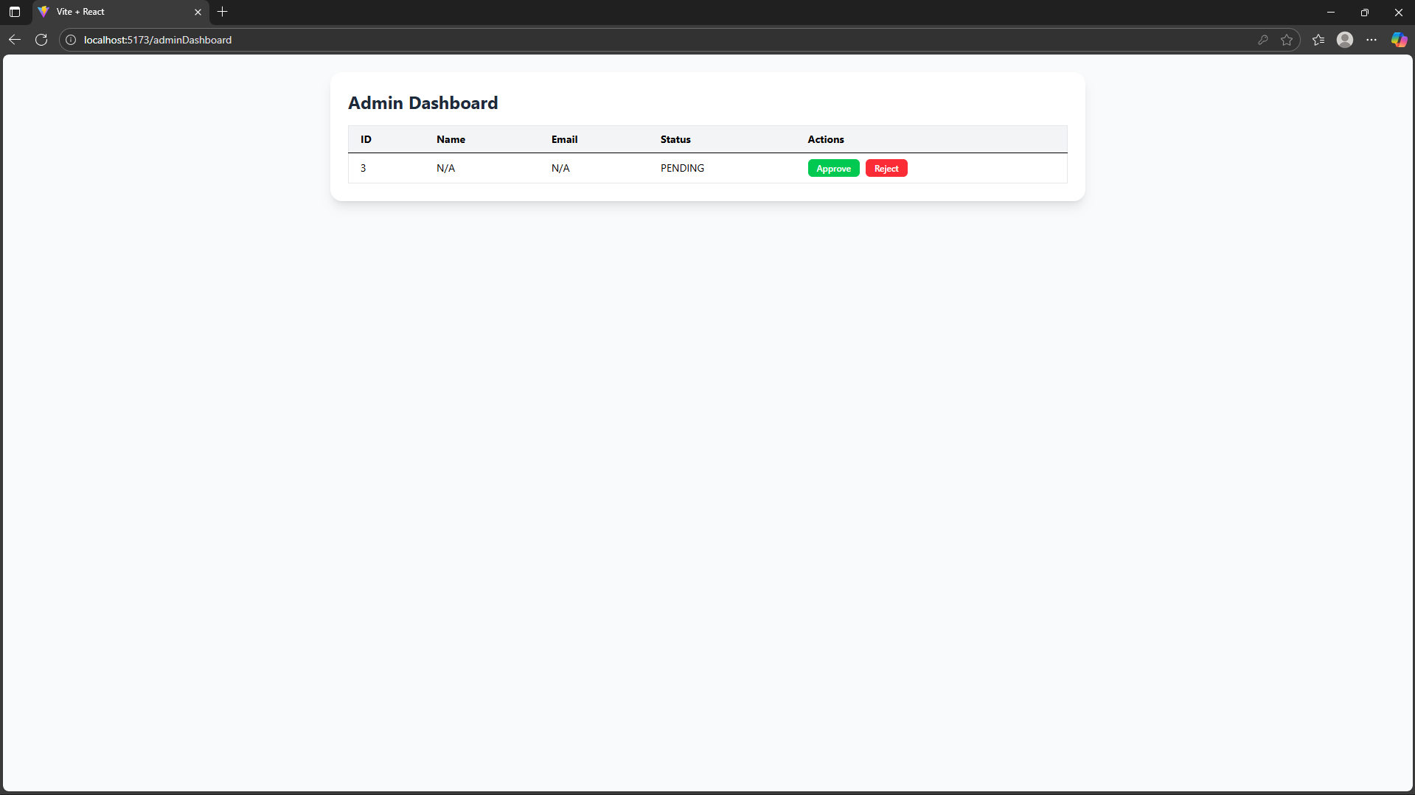
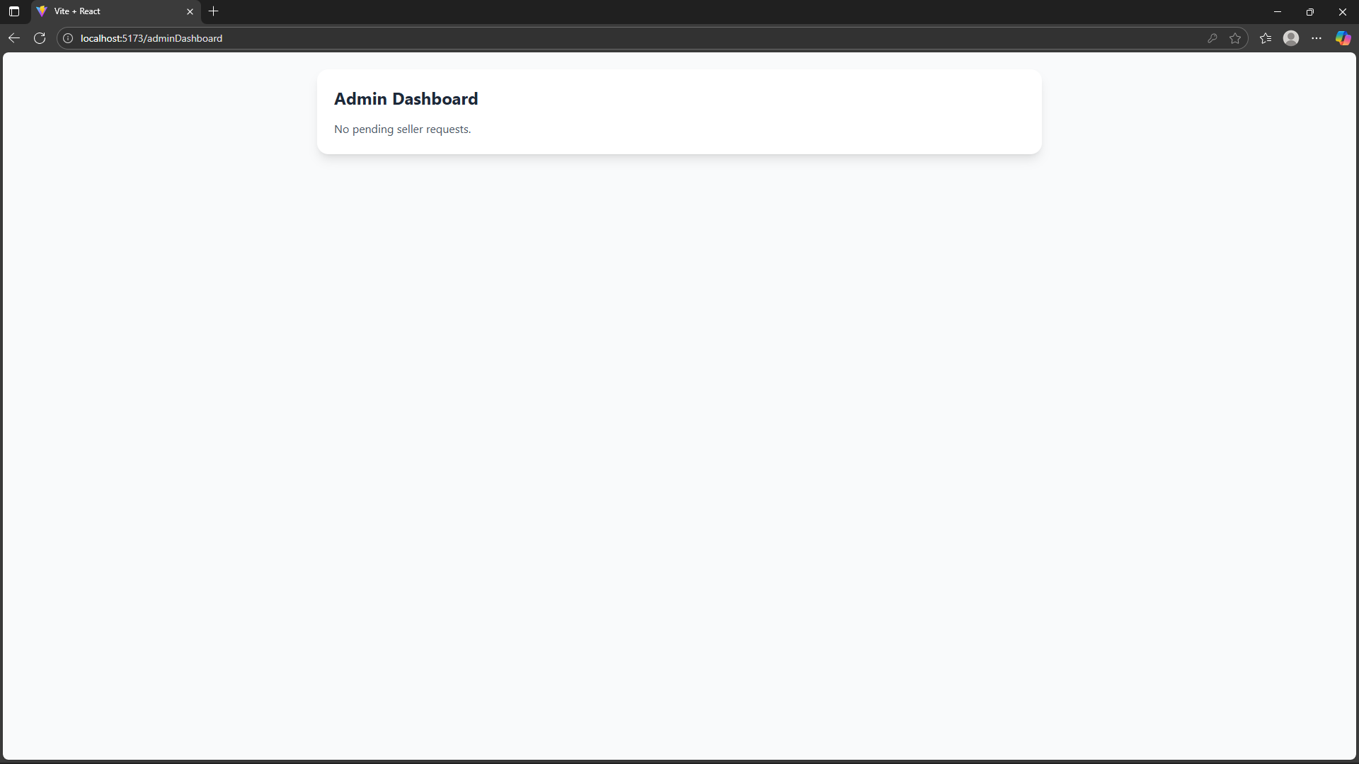
Admin Dashboard:

Slide 14
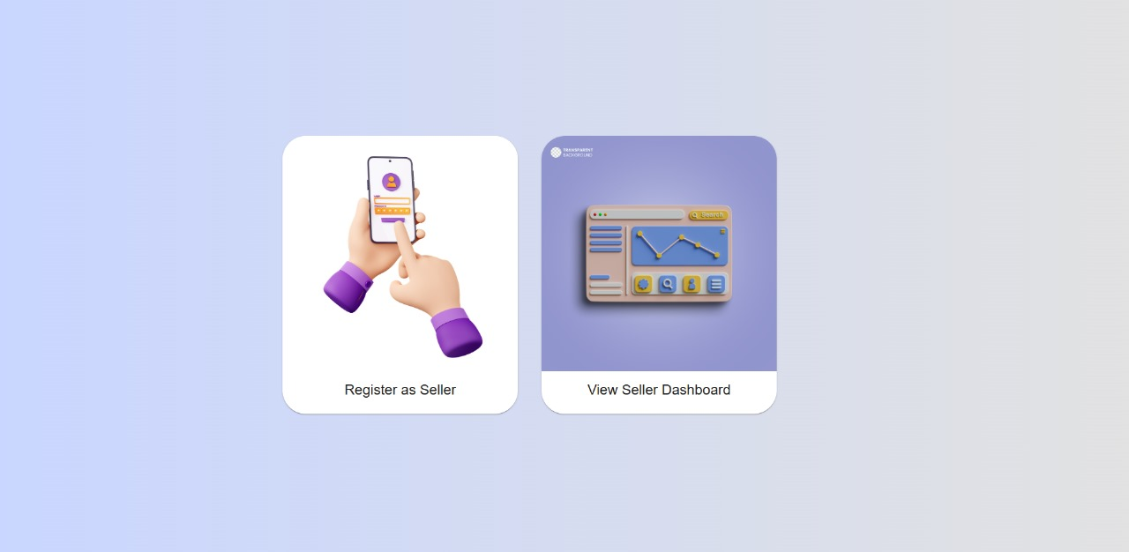
Seller page:

Slide 15
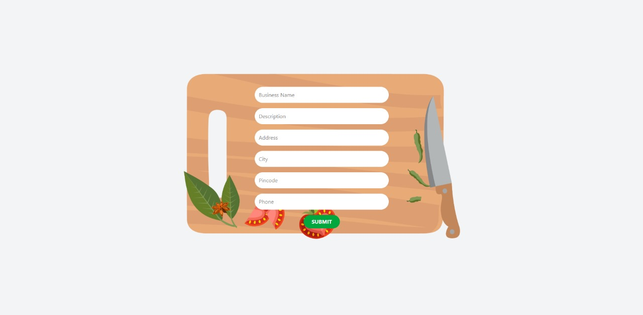
Seller registration page:

Slide 16
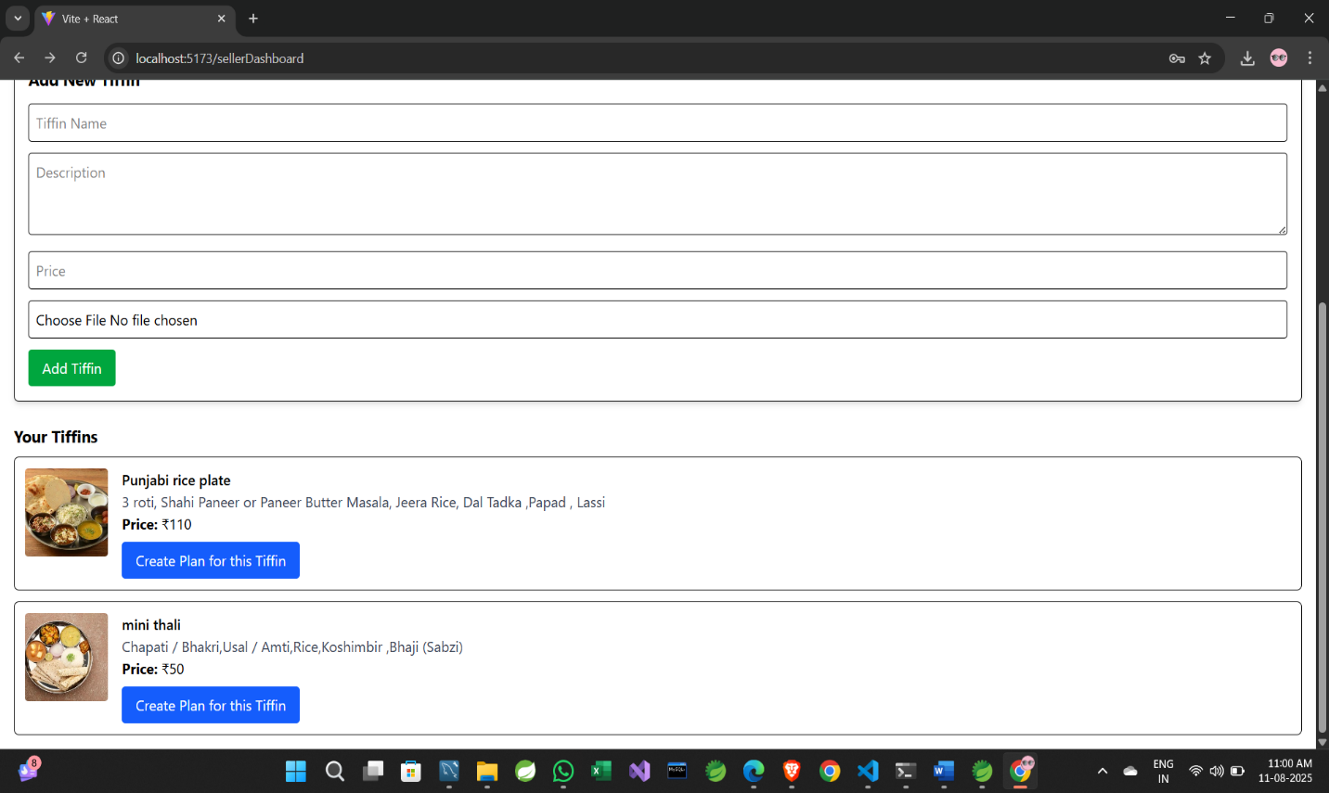
Seller page:

Slide 17
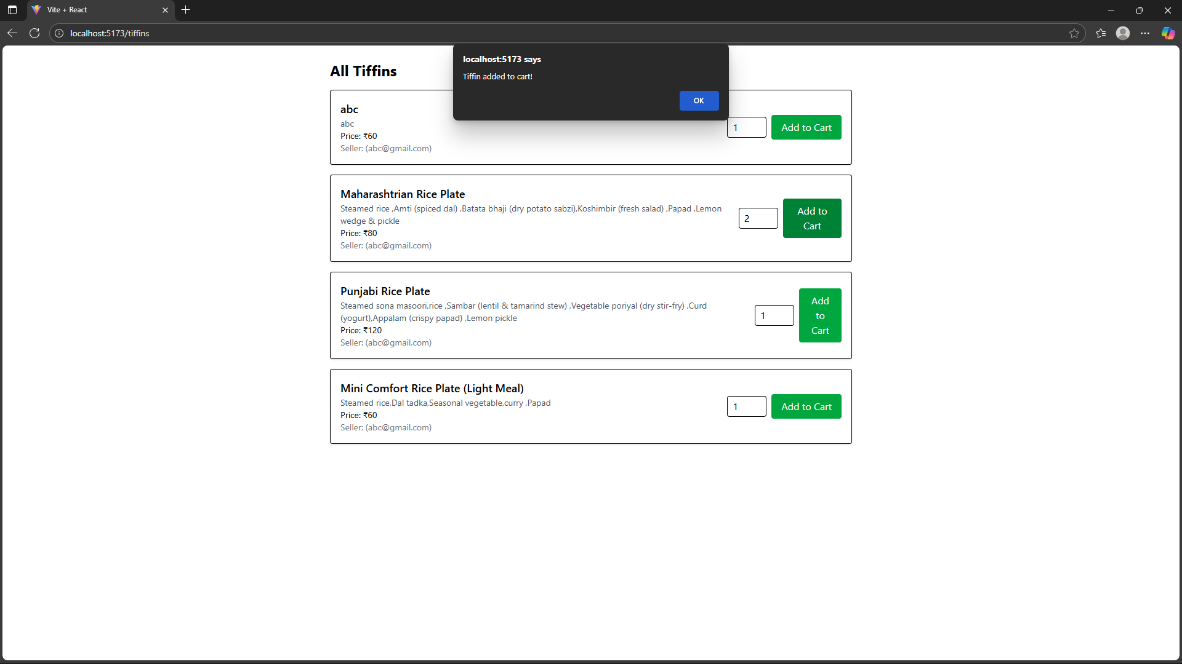
Add Tiffins :

Slide 18
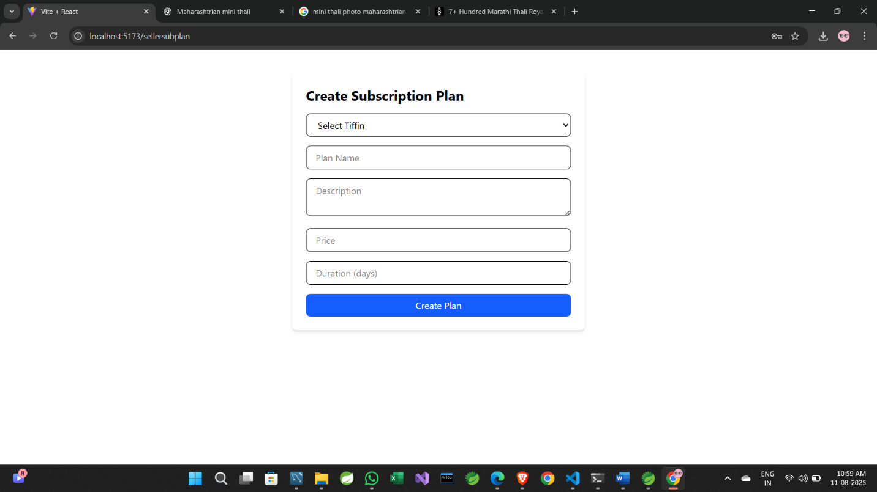
Seller creates subscription plan:

Slide 19
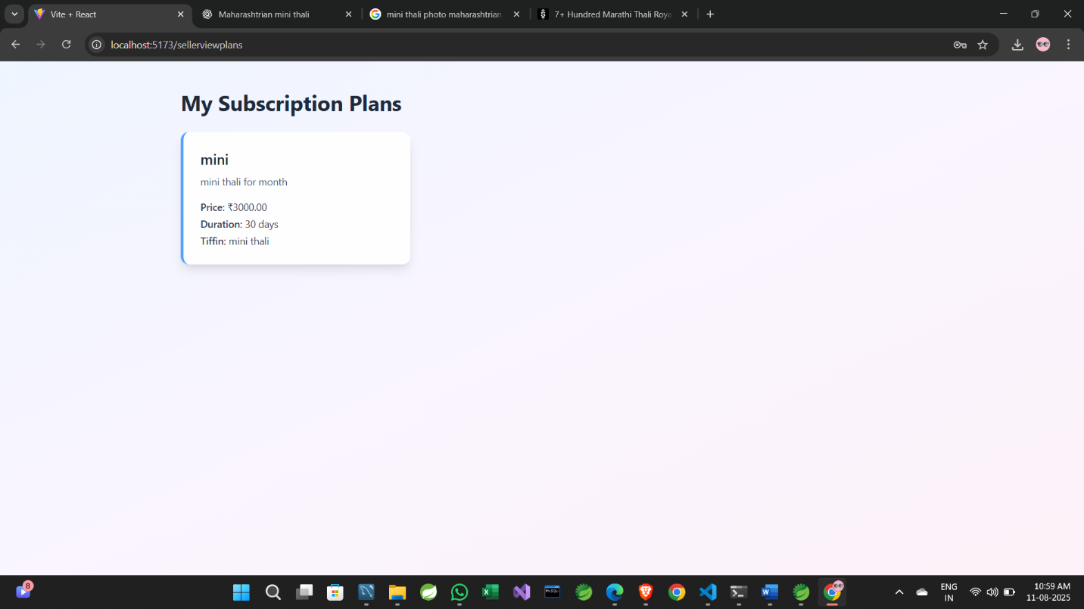
View created plans:

Slide 20
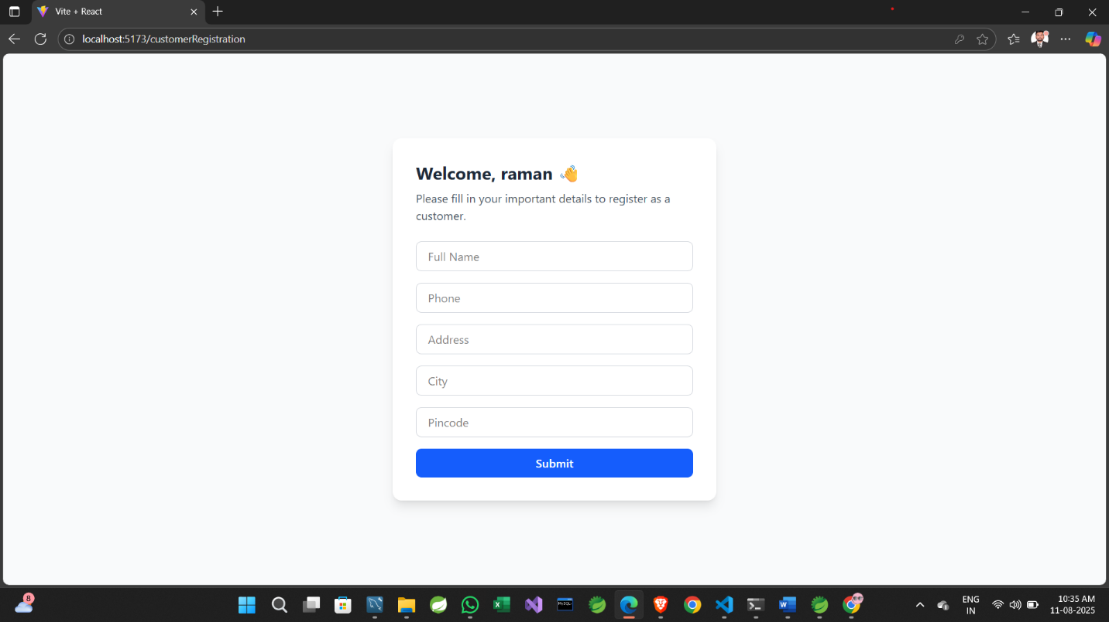
New Customer Register:

Slide 21
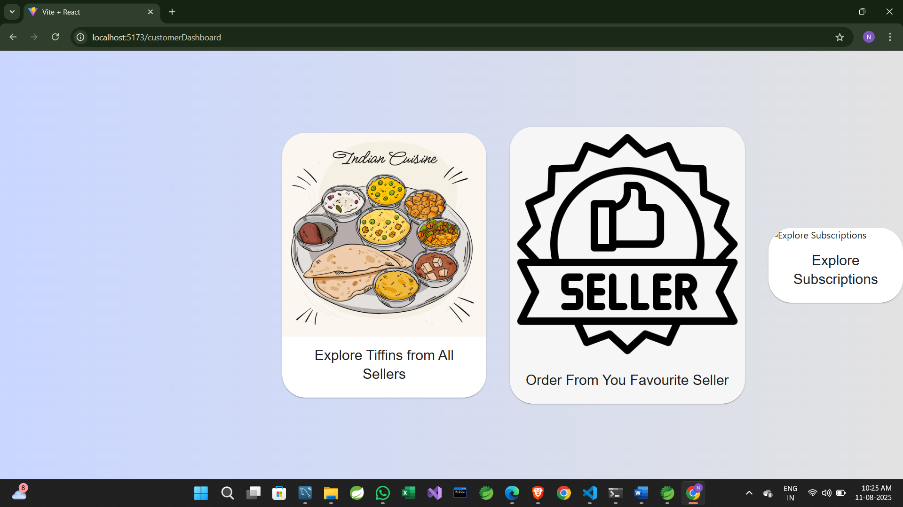
Customer dashboard:

Slide 22
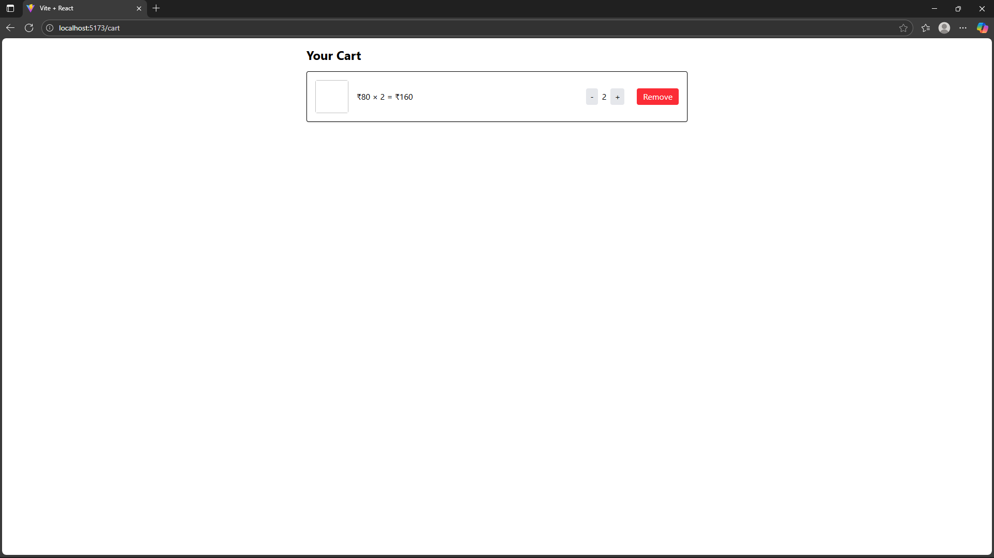
Cart page:

Slide 23
Future Scope and Extensions:
Integration of delivery tracking system.
AI-based meal recommendations.
Mobile app for Android and iOS.
Advanced analytics for vendors.
Subscription management automation

Slide 24
Conclusion
Tiffin Trail digitizes the traditional tiffin service process.
It enhances operational efficiency for vendors and convenience for customers.
Built on modern technologies ensuring scalability and security.
A reliable and efficient platform for meal delivery services.

Slide 25
Thank you

